Slide 1
BRIEF HISTORY
A computer understands and executes instructions represented in binary code, which consists of only 0s and 1s, also known as machine language. The first programming languages were, in fact, machine language, also known as 1GL (First-generation language - directly understood by the processor).
The earliest computers were programmed using machine language, which was very difficult to debug and not portable between different systems.
Thus, the assembly language was developed (which is a more human-readable way to write machine-level instructions), along with a language translator called the assembler, which converts assembly language into machine language. However, writing code in assembly language can be very tedious and time-consuming because the instructions are low-level and closely tied to the architecture of the hardware. It requires detailed management of memory, registers, and hardware-specific operations. It is platform-dependent. Code written for one type of processor cannot run on another without significant modification. This lack of portability makes it difficult to develop software that can run on different platforms.
To address the above mentioned drawbacks of assembly language like complexity and lack of portability, programmers and developers often use high-level programming languages (e.g., C, C++, Python), which offer abstraction, readability, and portability, while assembly language remains crucial for low-level tasks and performance-critical applications.

Slide 2
EMERGENCE OF COMPILERS AND INTERPRETERS
With the emergence of high-level programming languages, there was a need for a language translator which can convert the high-level language to assembly language, which is then converted by an assembler to machine language.
This language translator which can convert the high-level language to assembly language is basically the compiler.
On the other hand, there is another type of language translator which differs from the compiler in the sense that it directly executes high-level code line by line without generating intermediate assembly or machine code files. It reads one line (or statement) of high-level code, converts it directly into machine instructions in memory and executes the machine instructions immediately. This process is then repeated for the next lines of code until the whole program is executed. This type of language translator is known as the interpreter.
Now let’s talk in detail about these two primary types of language translators – compilers and interpreters.

Slide 3
BASIC FLOW CHART – In a C Program
C Program (High level Language)
After handling preprocessor directives
PREPROCESSOR
COMPILER
Assembly language
ASSEMBLER
Relocatable machine code
Absolute machine code (.exe, .out)
LINKER / LOADER

Slide 4
PHASES OF A COMPILER
C code after preprocessing (character stream)
Symbol Table
Token stream
Lexical Analysis
Syntax Analysis
Parse tree
Semantic Analysis
Annotated Parse Tree
Assembly code
Target Code Generation
Code Optimisation on Intermediate code
Intermediate Code Generation
Intermediate code
Intermediate code
Error Handler

Slide 5
ERROR HANDLER
Error handler is responsible to continue the compilation process even if any error occurs at any phase (1, 2 or 3). After phase 3 if the error handler object is empty, then the source code is free of error and it can be converted into target code. If the error handler object is not empty, the compilation process is terminated and the errors are displayed.
There are three types of compilation errors:
Lexical Error
Syntax Error
Semantic Error
However, runtime errors cannot be handled by compiler.

Slide 6
PASSES
Pass refers to the traversal of a compiler through the entire program.
There are two types of compilers:
Single-Pass Compiler
Multi-Pass Compiler
Single-Pass Compiler:
One-Time Processing – Reads and processes the source code in a single pass, translating it directly into assembly code.
Speed Advantage due to single traversal of source code
Memory efficient as it does not store extensive intermediate state information
Optimization limitations
Best for simple languages
Example: Early FORTRAN compilers
Multi-Pass Compiler:
Multiple scans of source code
Advanced Optimizations
Context Awareness: Deeper understanding of the program’s context which allows for more sophisticated error checking and optimization.
Memory usage: More than single-pass compilers as they need to maintain intermediate representations of the source code between passes.
Example: GCC

Slide 7
BOOTSTRAPPING
Initially, compilers were written in assembly language or a low-level language specific to the hardware. As programming languages evolved, the need for writing compilers in a higher-level language became evident.
Thus, bootstrapping emerged which refers to writing a compiler in the same language it intends to compile.
A simple compiler is first written in a low-level language. This is often termed as the bootstrap compiler. The compiler is then rewritten in its own higher-level language and compiled using the bootstrap compiler. This process can be iterated, with each new version of the compiler used to compile its next version.
Advantages:
Ensures that the compiler is compatible with the language it is designed to compile, thus it is better able to understand and interpret the syntax and semantics of the language.
Greater control over the optimization and code generation process.

Slide 8
LEXICAL ANALYSIS
The lexical analyzer takes the C program (stream of characters) as input, scans every character of the program and groups characters into lexemes to produce the token stream.
First phase to communicate with the symbol table which is generated in this phase
Besides tokenizing, the lexical analyzer also removes whitespaces (spaces, tabs, newlines), ignores comments (starting with //), and reports lexical errors to the error handler (like illegal characters: @, # etc. in variable names).
Lexemes | Tokens
int | Keyword
x | Identifier
= | Operator
5 | Literal
+ | Operator
y | Identifier
; | Separator
Example:
int x = 5 + y;
int 1abc; → invalid sequence
char ch = ‘a; → end quote missing
Lexical Errors

Slide 9
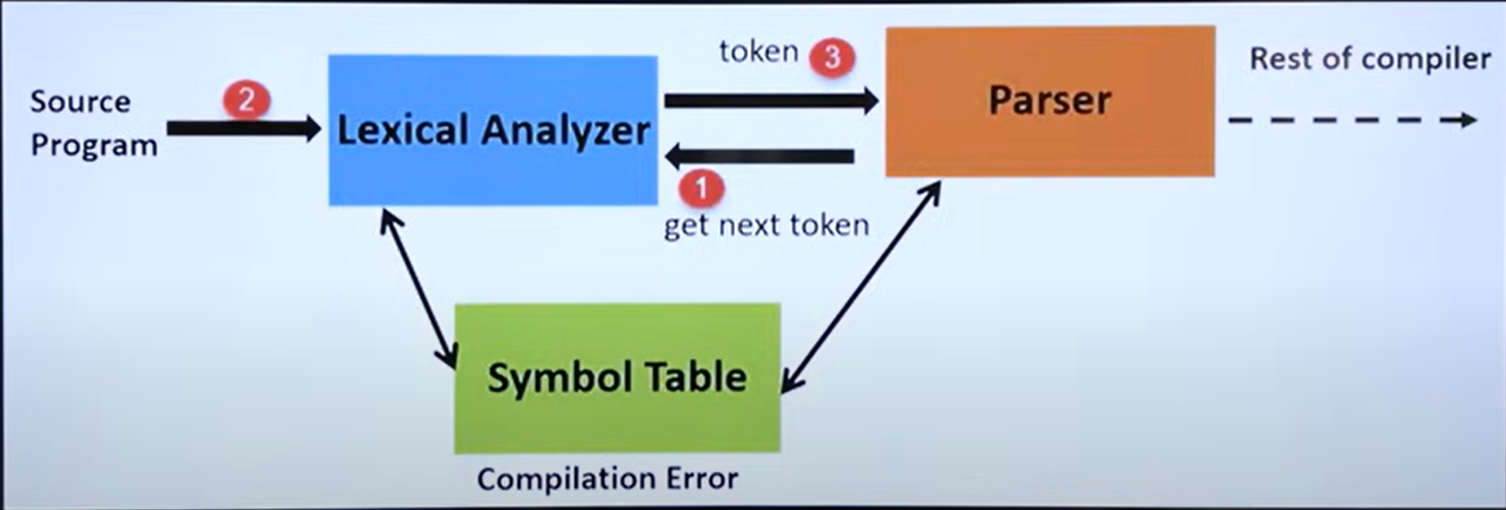
LEXICAL ANALYSIS

Slide 10
IMPLEMENTATION OF LEXICAL ANALYZER
Input to the lexical analyzer is a source program.
By using input buffering scheme it scans the source program.
Regular expressions are used to represent the input patterns.
The input pattern is converted into NFA.
NFA is converted into DFA which is further optimized to form minimalist DFA.
The minimized DFA are used to recognize the pattern and the character stream is broken into lexemes.
Each minimized DFA corresponds to a specific token pattern (regular expression) which identifies lexemes that match the regular expressions.
A lexical analysis tool (like Lex) constructs a state transition table for the corresponding finite automaton, and then generates code that includes this table, the logic for identifying tokens (evaluation phase), and a routine that uses these components to scan and tokenize the input source program.

Slide 11
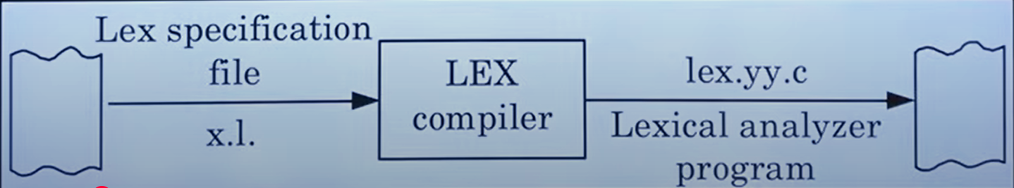
ABOUT LEX
Lexical analysis phase can be automated using a tool called LEX.
LEX scans the source program in order to get the stream of tokens and these tokens can be related together so that various programming structure such as expression, block statements, control structures, procedures can be recognized.
A LEX specification file (which stores the regular expressions for the tokens) is given to LEX compiler to produce a C program which is the lexical analyzer program.
This C program consists of the tabular representation of the transition diagrams constructed for the regular expressions.

Slide 12
SYNTAX ANALYSIS
Formal grammar represents the specification of the programming language with the use of production rules.
The syntax analyzer basically checks the syntax of the language.
A syntax analyzer takes the tokens from the lexical analyzer and groups them in such a way that some programming structure can be recognized.
After grouping the tokens if at all any syntax cannot be recognized (derivation tree cannot be generated), then syntactic error will be generated.
This syntax can be checked in the compiler by writing the specifications.
Specification tells the compiler how the syntax of the programming language should be.
YACC:
Tool used in compiler construction to generate a parser from a specified grammar.
Takes the grammar of a language in the BNF form and produces C code for a parser.

Slide 13
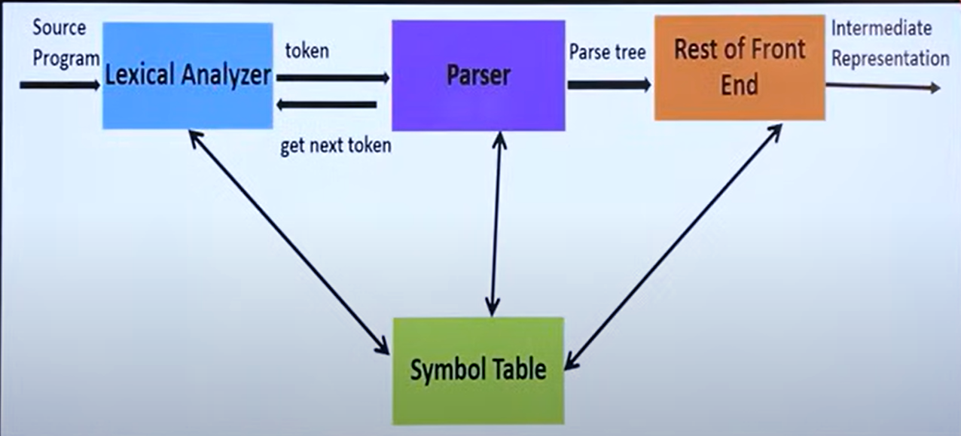
SYNTAX ANALYSIS

Slide 14
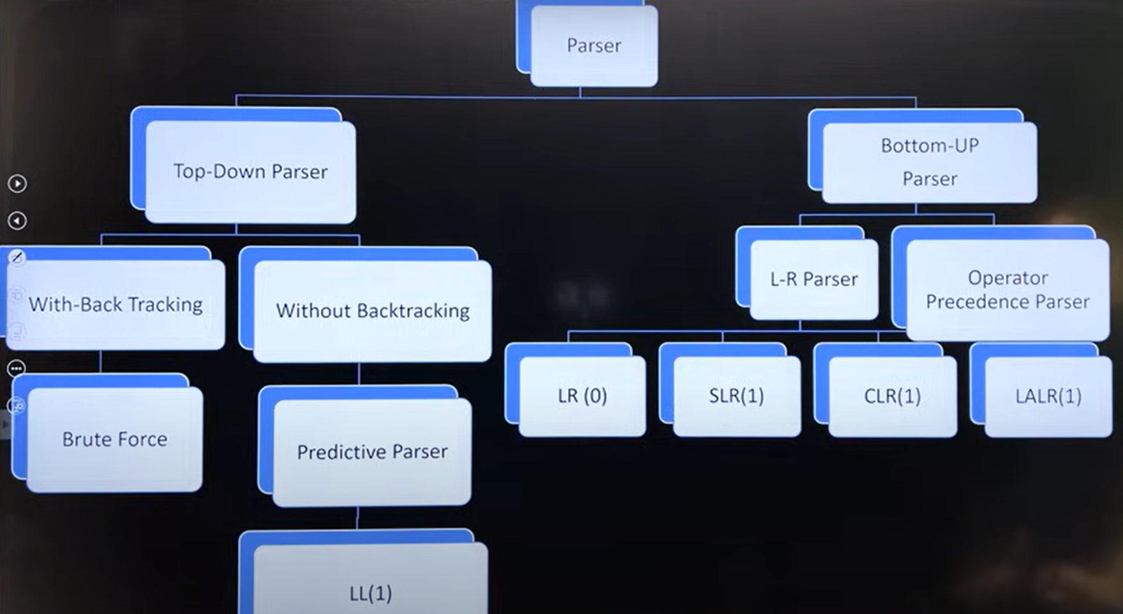

Slide 15
PROBLEMS FOR DESIGNING TOP DOWN PARSER
Non-Deterministic Grammar – The grammar with common prefix is known as non-deterministic grammar.
Example: A → ab/ac
The grammar with common prefixes requires a lot of back-tracking, which is time consuming. To avoid back-tracking, we need to remove the common prefixes, i.e., convert non deterministic to deterministic.
Converting the above example,
A → aD
D → b/c
Recursive Production – Production having same variable both at left and right hand side of production is known as recursive production.
Example: S → aSb
In top-down parsing approach, we use left derivation. Thus, left recursion becomes a problem in this case.
So, we need to convert it into right recursion to solve this issue.
Ambiguous Grammar – The CFG is said to be ambiguous if there are more than one derivation tree for any string. Sometimes the language is inherently ambiguous and we cannot write an unambiguous language for that. If there are both left and right recursion, then the grammar is surely ambiguous.

Slide 16
LL(1) PARSER
First L means left to right scanning
Second L means Left Most Derivation
1 means number of look ahead symbol
To predict the required production, to extend the parse tree, LL(1) parser depends on current processing symbol. The current processing symbol is called as look ahead symbol.
LL(1) parser consists of three components:
Input Buffer
Parse Stack
Parse Table
Input Buffer:
It is divided into finite number of cells and each cell is capable of holding only one input symbol.
Input buffer contains only one input string at any point of time.
The tape header is always pointing to only one look ahead symbol and after parsing the current look ahead symbol, the header moves to next cell towards right side.
End of the string is recognized by $.

Slide 17
LL(1) PARSER
Parse Stack:
It contains the grammar symbol, the grammar symbol is pushed into stack or popped from the stack based on occurrence of matching.
If the top most symbol of the stack is matching with look ahead symbol, then the grammar symbol is popped out from the stack.
If it is not matching, the grammar symbol is pushed into stack.
Parse Table:
It is a 2 dimensional array of order m x n where m = number of non terminals and n = number of terminals + 1
Parse table contains all the production which are used to make the parse tree for that input string
For constructing the parse table, we must find first and follow of each non terminal and fill in the table
The parsing process is done and in the end if the stack becomes empty, the input string is accepted and parse tree can be formed.
While constructing the parse table, if there are no multiple entries in a cell, it is LL(1) grammar.

Slide 18
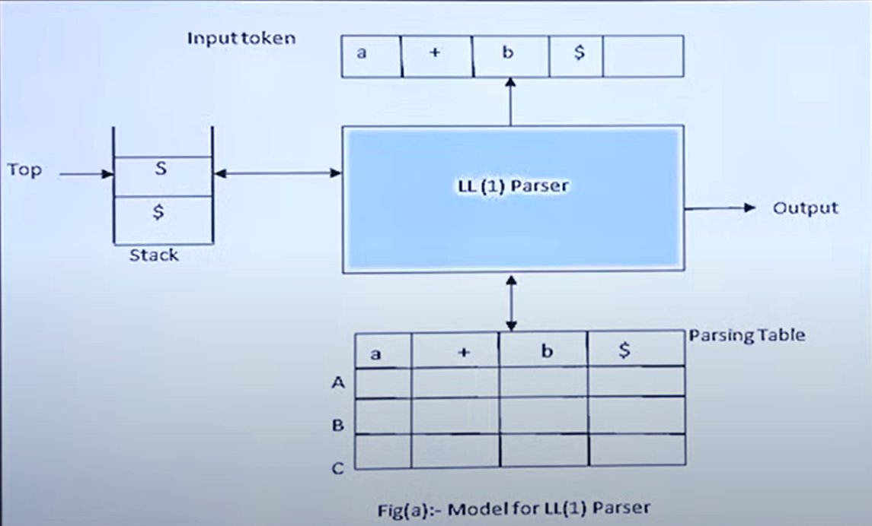
LL(1) PARSER

Slide 19
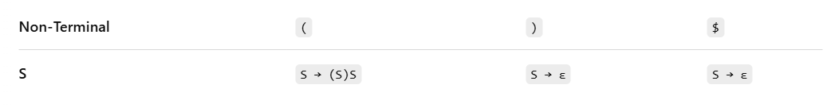
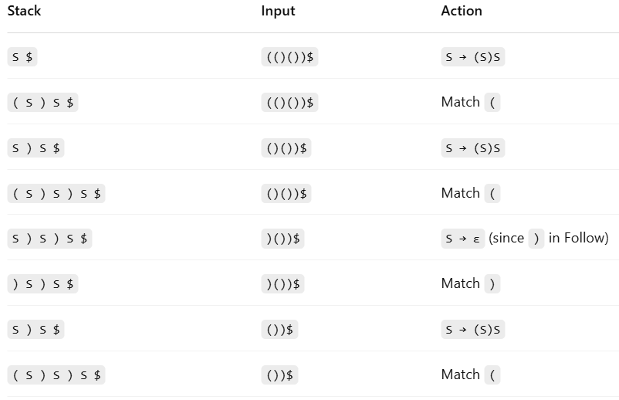
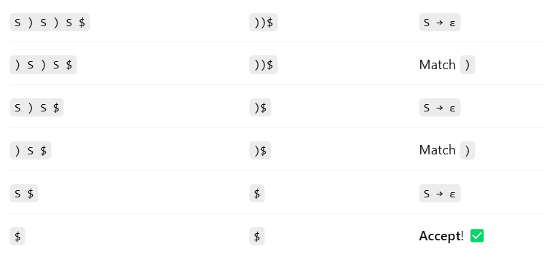
LL(1) PARSER - example
CFG:
1. S → ( S ) S
2. S → ε
First(S) = { '(', ε }
Follow(S) = { ')', $ }
Input string: (()())$

Slide 20
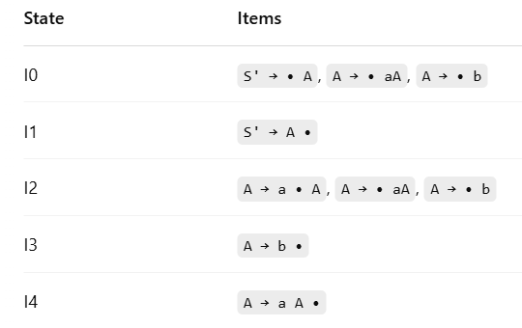
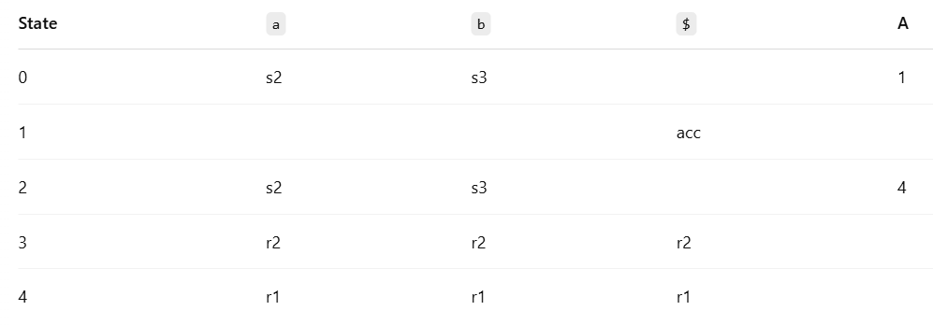
LR(0) PARSER - example
CFG:
0. S' → A ← Augmented production
1. A → aA
2. A → b
Input string: aab$

Slide 21
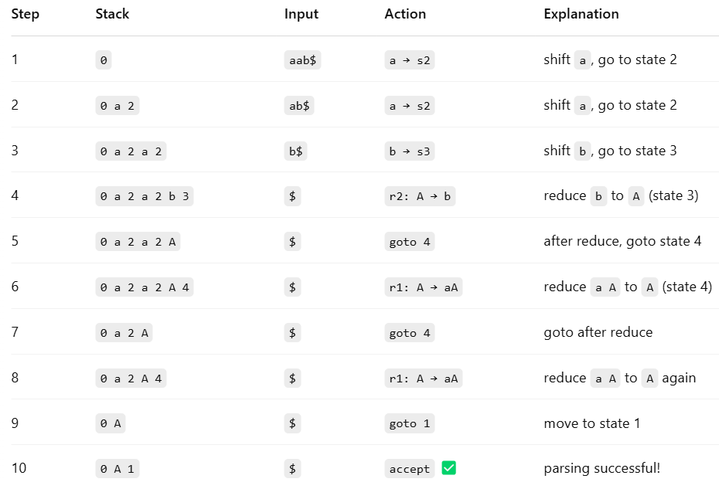
LR(0) PARSER - example

Slide 22
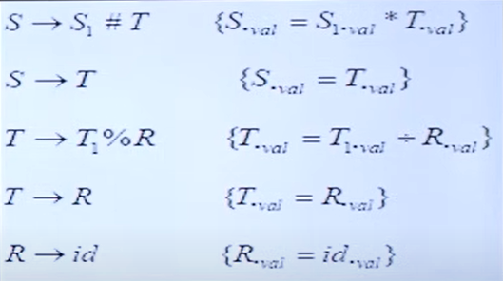
SEMANTIC ANALYSIS
It performs type checking, scope resolution, validates semantic consistency, ensuring that the operations and expressions in the source code are according to the language’s rules and semantics.
Grammar + Semantic Rules + Semantic Actions = Syntax Directed Translation (generalization of CFG)
Attributes attach relevant information like strings, numbers, types, memory locations, or code fragments to grammar symbols of a language which are used as labels for nodes in a parse tree.
The value of each attribute at a parse tree node is determined by semantic rules associated with the production applied at that node, defining the context specific information for the language construct.
Classification:
Synthesised attributes
Inherited attributes

Slide 23
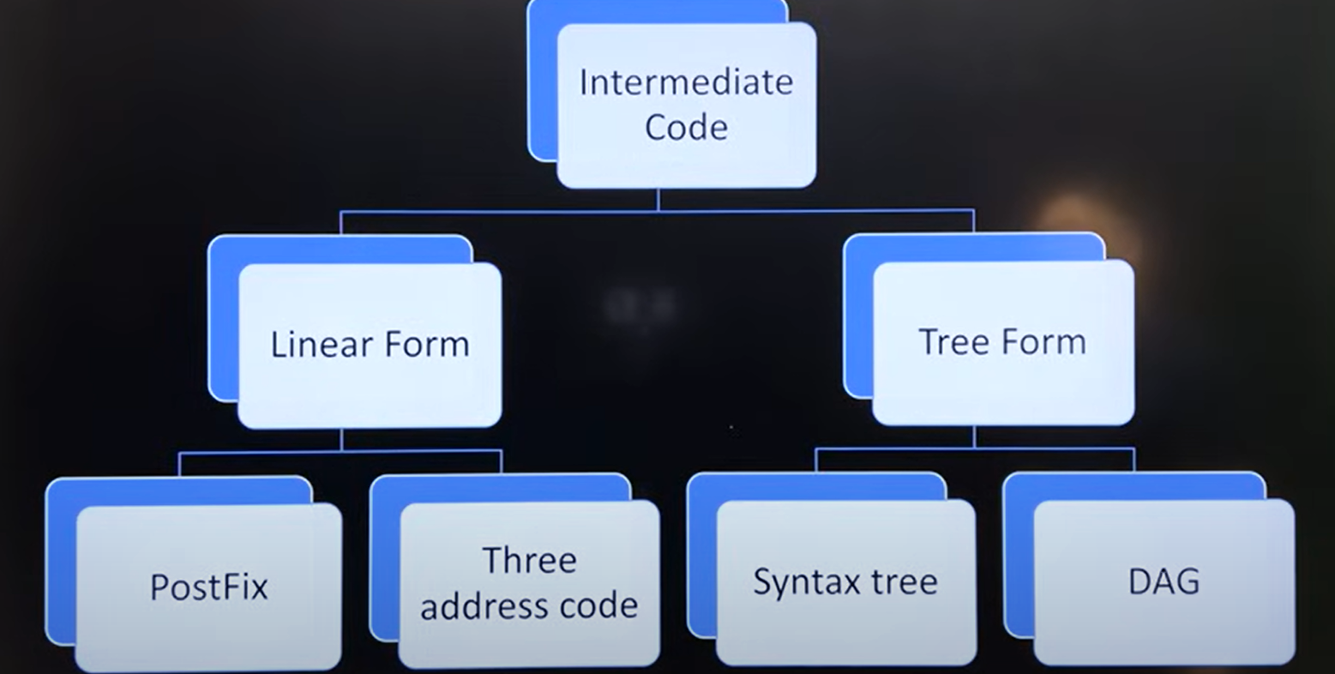
INTERMEDIATE CODE GENERATION
Intermediate code generation in compilers creates a machine-independent, low-level representation of source code, facilitating optimisation and making the compiler design more modular.
Portability
Optimisation opportunities
Ease of compiler construction

Slide 24
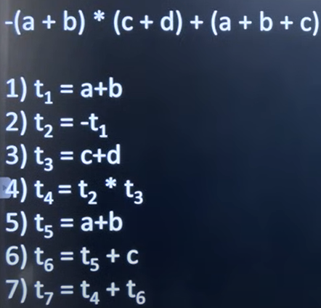
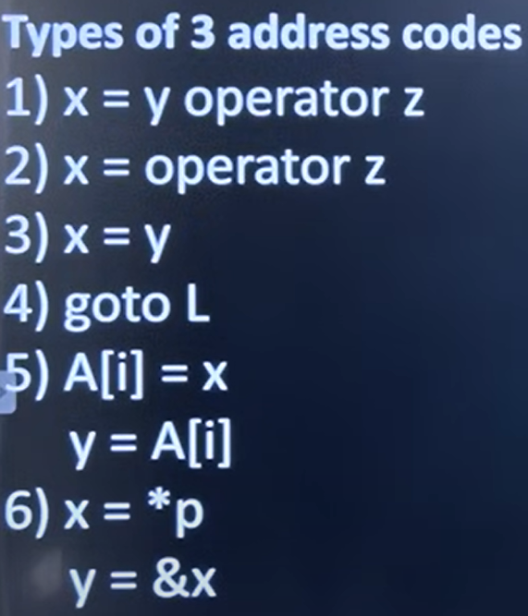
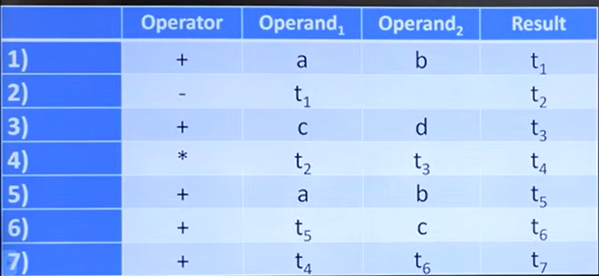
THREE ADDRESS CODE
Three-address code is a type of intermediate code where each instruction can have at most 3 operands and one operator. It simplifies complex operations into a sequence of simple statements supporting various operators for arithmetic, logic or Boolean operations.

Slide 25
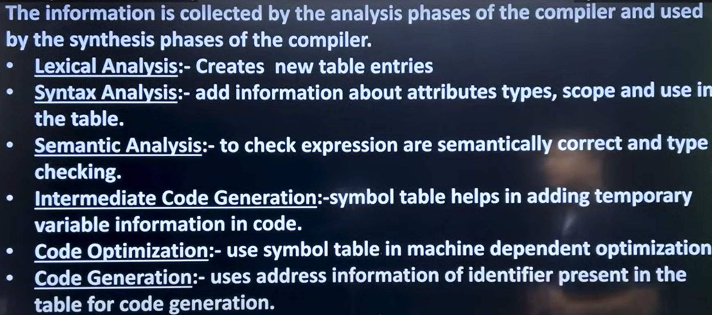
SYMBOL TABLE
The symbol table is a data structure used by a compiler to store information about the source program’s variables, functions, constants, user-defined types and other identifiers.
It helps the compiler track the scope, life and attributes (like value, type, size of each identifier). It is essential for semantic analysis, type checking and code generation.
A symbol table should possess these essential functions: Lookup, Insert, Access, Modify, Delete
Different data structures used to implement symbol table:
Unordered list
Ordered list
Search Tree
Hash Tables

Slide 26
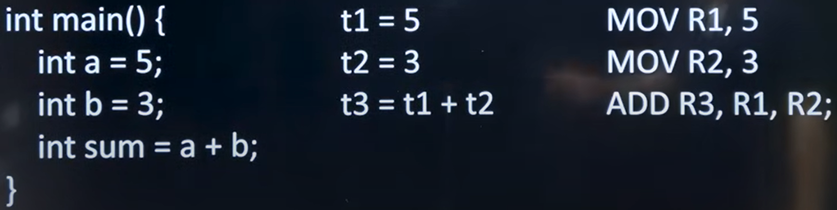
CODE GENERATION
Code generation is the process of converting the intermediate code representation of source code into a target code which is also optimised.
It involves translating the syntax and semantics of the high-level-language into assembly level code.

Slide 27
CODE OPTIMISATION
Loop Optimisation:
To apply loop optimisation, we must first detect loops.
For detecting loops use control flow analysis using program flow graph
To find PFG, find basic blocks
A basic block is a sequence of 3 address statements where control enters at the beginning and leaves only at the end without any jumps or halts
Loop Jamming:
Combining the bodies of two loops whenever they share the same index and the same number of variables
Loop Unrolling:
Getting the same output with less number of iteration is called loop unrolling
Loop Invariant code motion:
Moving the loop independent statements out of the loop

Slide 28
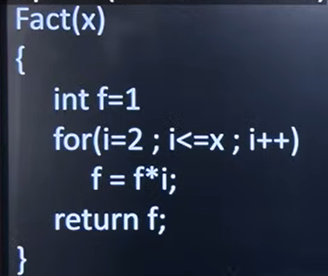
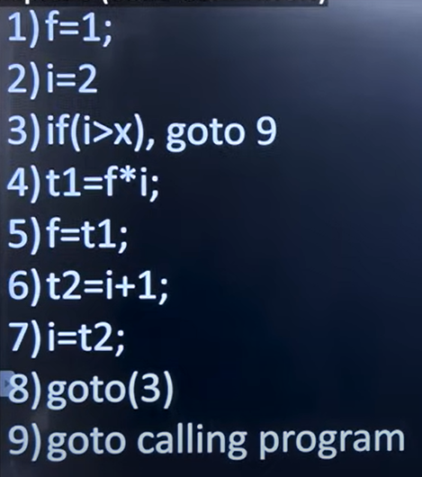
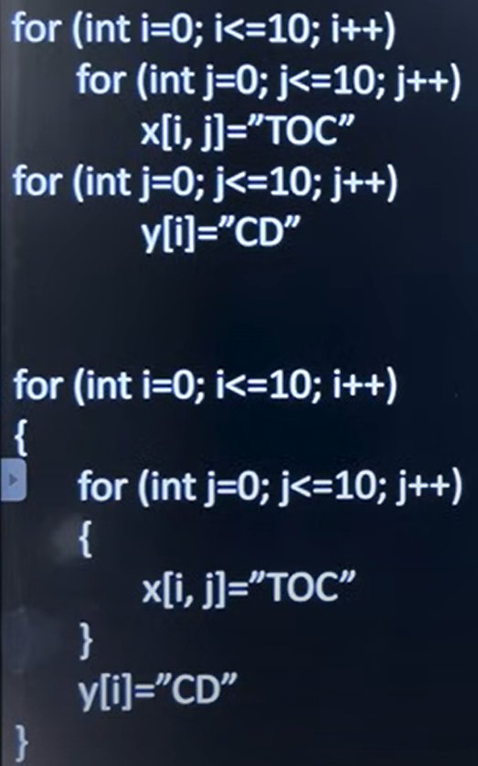
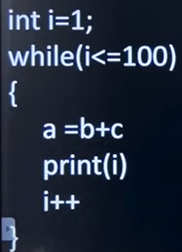
1,2 – block 1
3 – block 2
4,5,6,7,8 – block 3
9 – block 4

